Slide 1
Java Multithreading

Slide 2
Introduction
Multithreading is a feature of Java that allows multiple threads to run simultaneously.
It helps perform more than one task at the same time.
It improves the performance and efficiency of applications.

Slide 3
What is a Thread?
A thread is the smallest unit of execution in a program.
It is also called a lightweight process.
Multiple threads can execute within a single program.

Slide 4
Why Use Multithreading?
To execute multiple tasks concurrently.
To improve CPU utilization.
To increase application responsiveness.
To reduce overall execution time.

Slide 5
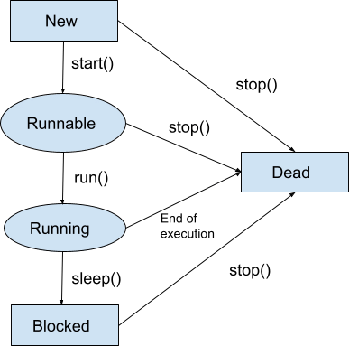
Life Cycle of a Thread
New: Thread is created.
Runnable: Thread is ready to run.
Running: Thread is currently executing.
Waiting/Blocked: Thread waits for resources or another thread.
Dead: Thread execution is completed.

Slide 6
Creating Threads in Java
Java provides two ways to create threads:
By extending the Thread class.
By implementing the Runnable interface.

Slide 7
Important Thread Methods
start() – Starts the thread.
run() – Contains the code to be executed.
sleep() – Pauses the thread for a specific time.
join() – Waits for another thread to finish.
isAlive() – Checks whether the thread is running.

Slide 8
Thread Synchronization
Synchronization controls access to shared resources.
It prevents data inconsistency.
It ensures thread safety.

Slide 9
Advantages of Multithreading
Better CPU utilization.
Faster execution of programs.
Improved application responsiveness.
Efficient use of system resources.

Slide 10
Disadvantages of Multithreading
Increases program complexity.
Debugging becomes difficult.
May lead to deadlock problems.
Requires careful synchronization.

Slide 11
Applications of Multithreading
Web browsers
Online games
Chat applications
Multimedia applications
Web servers

Slide 12
Conclusion
Multithreading is an important feature of Java.
It allows multiple tasks to run simultaneously.
It improves performance and user experience.

Slide 13
THANK YOU

